Slide 1
Day 5: Scientific Papers

Slide 2
For the first 10 minutes of class, teach your group about the paper you read yesterday.

Slide 3
Paper 1: Replication can help strengthen research, and failure to replicate an experiment should result in scientific discourse to pinpoint whether there is no “true” effect or whether the effect is simply small. Failure to replicate and replication are equally important to report.
Paper 2: When using data collected by another source, make sure that it’s reliable. You don’t want to analyze brown bears with your Bigfoot!
Paper 3: If you run multiple tests on a dataset, you are more likely to get a false positive result. Choose an appropriate p-value for your dataset.
Paper 4: Manipulating your data groups after you have experimental results can bias your data. Make a plan for your analysis and don’t change it based on the results.

Slide 4
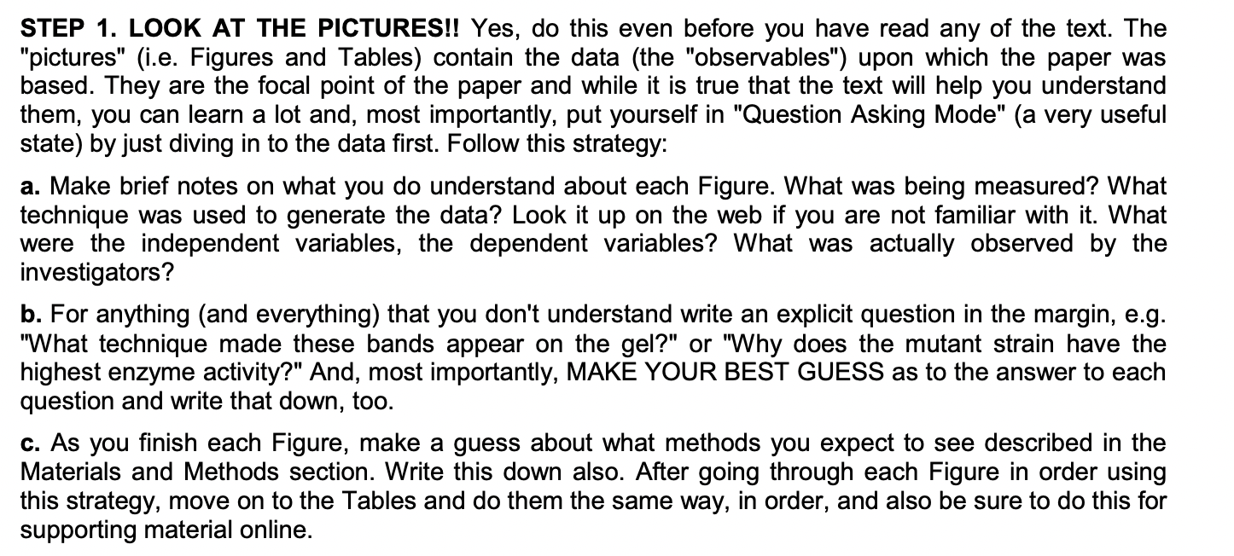
How to Read A Scientific Paper

Slide 5
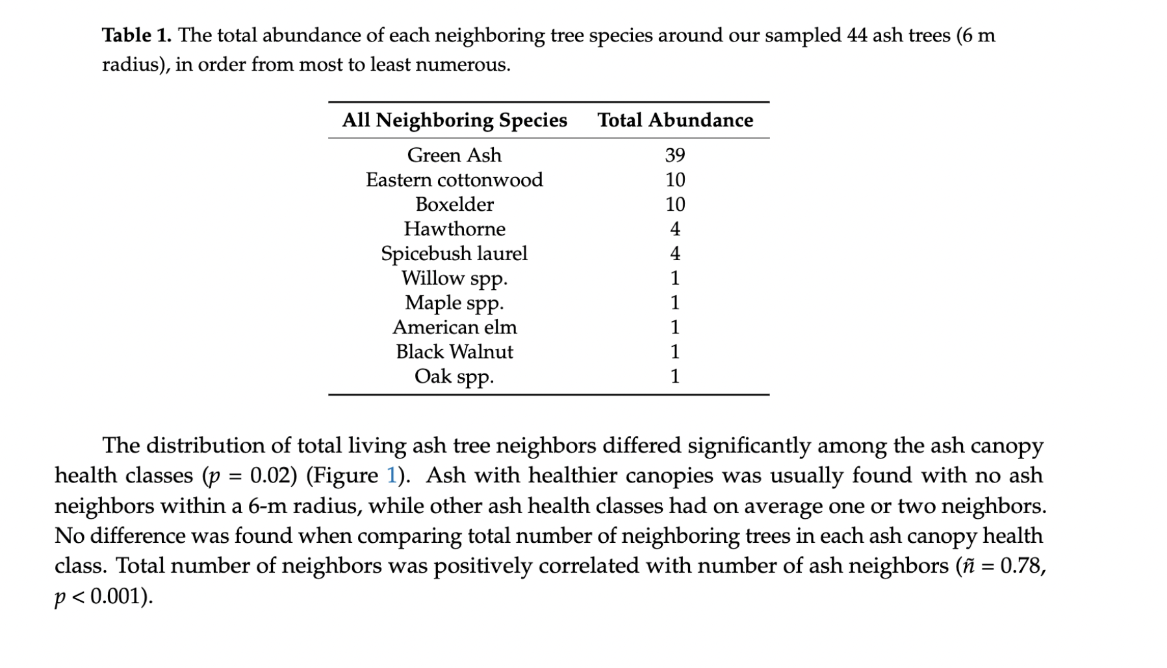

Slide 6
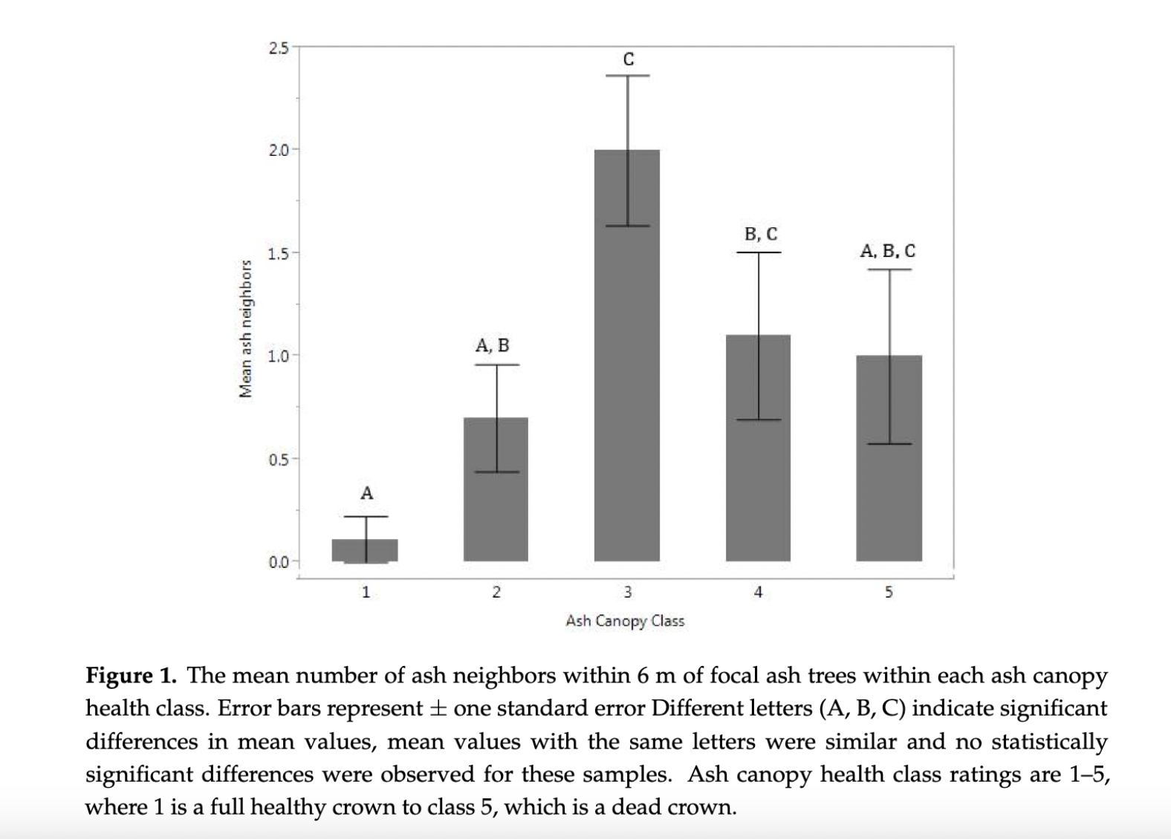

Slide 7
Which canopy health class is not significantly different from any of the others?

Slide 9
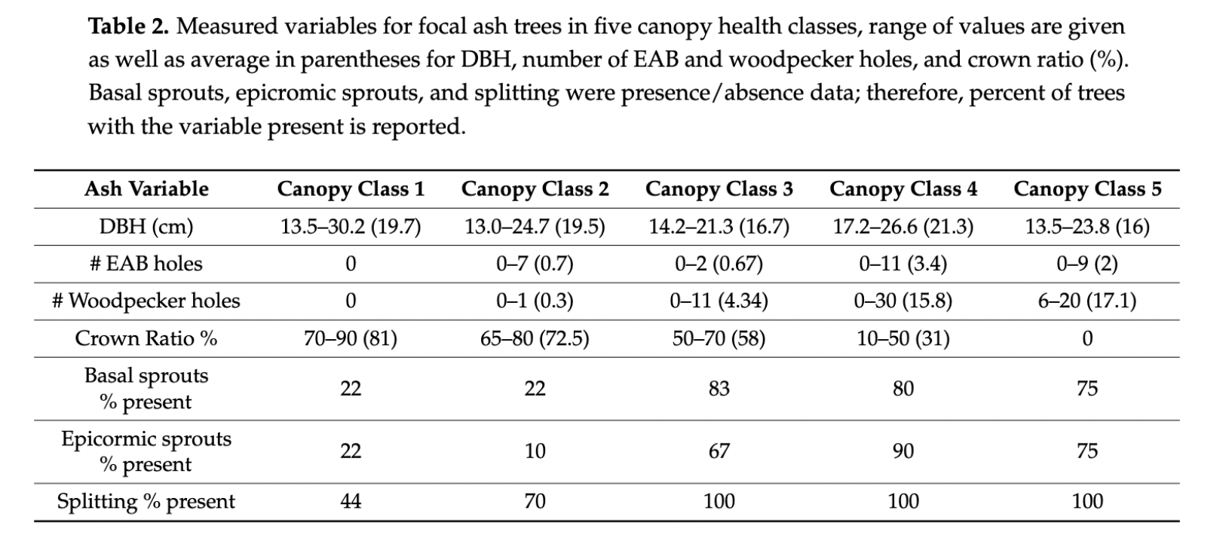

Slide 10
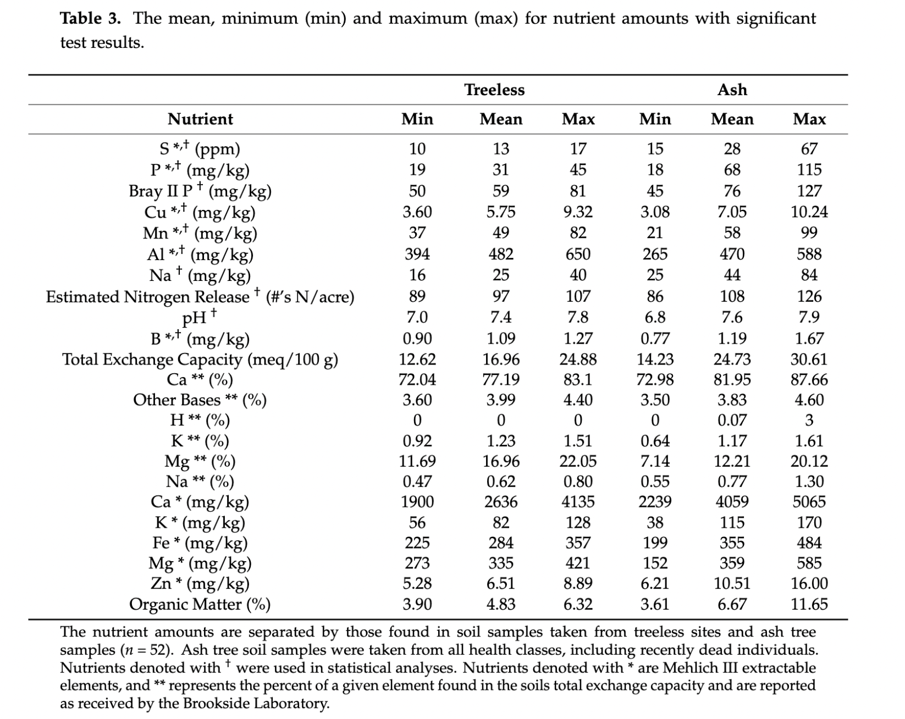

Slide 11
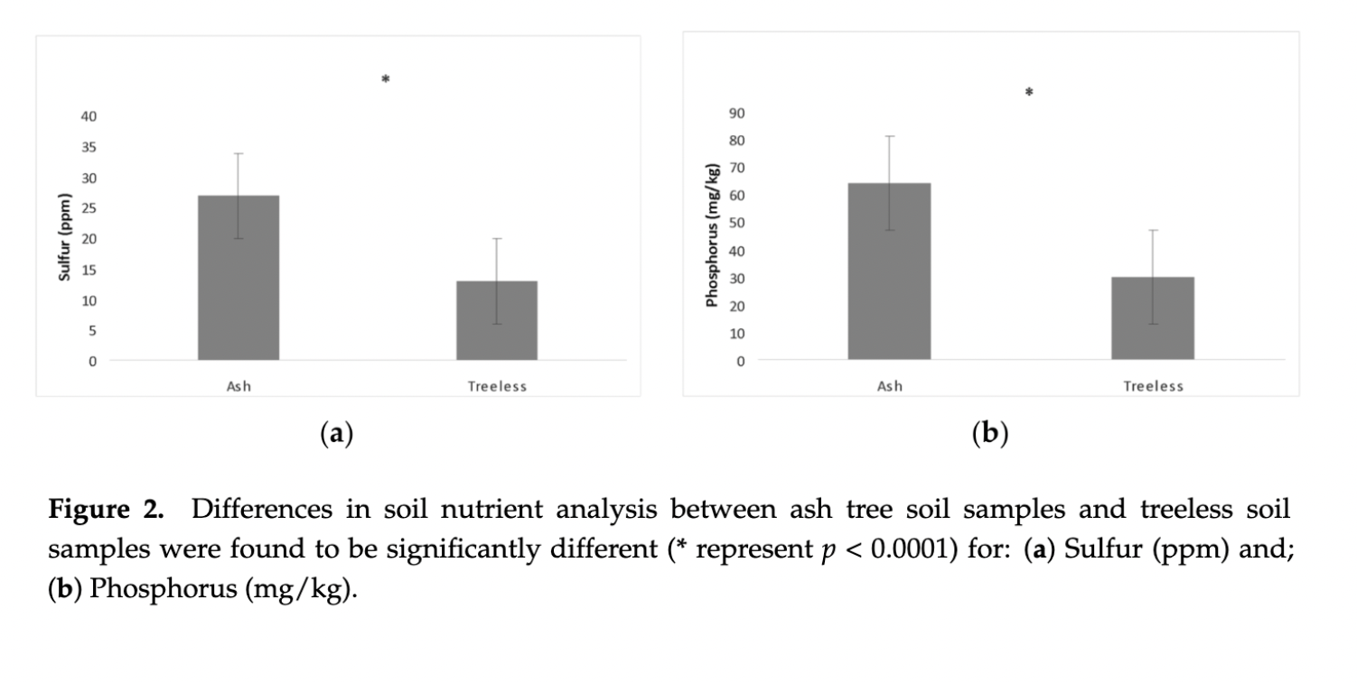

Slide 12
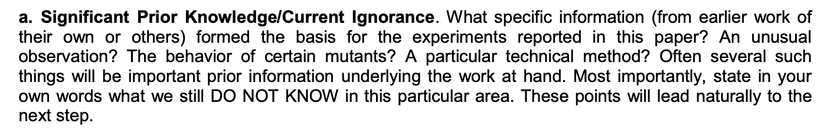
How to Read A Scientific Paper

Slide 13
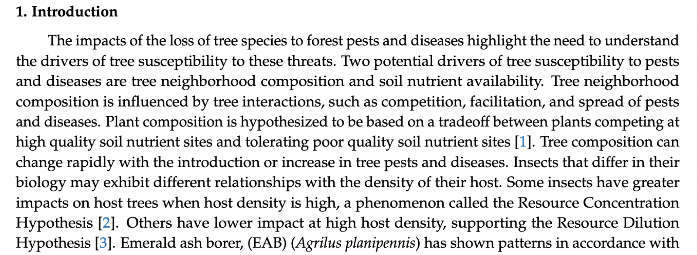

Slide 14
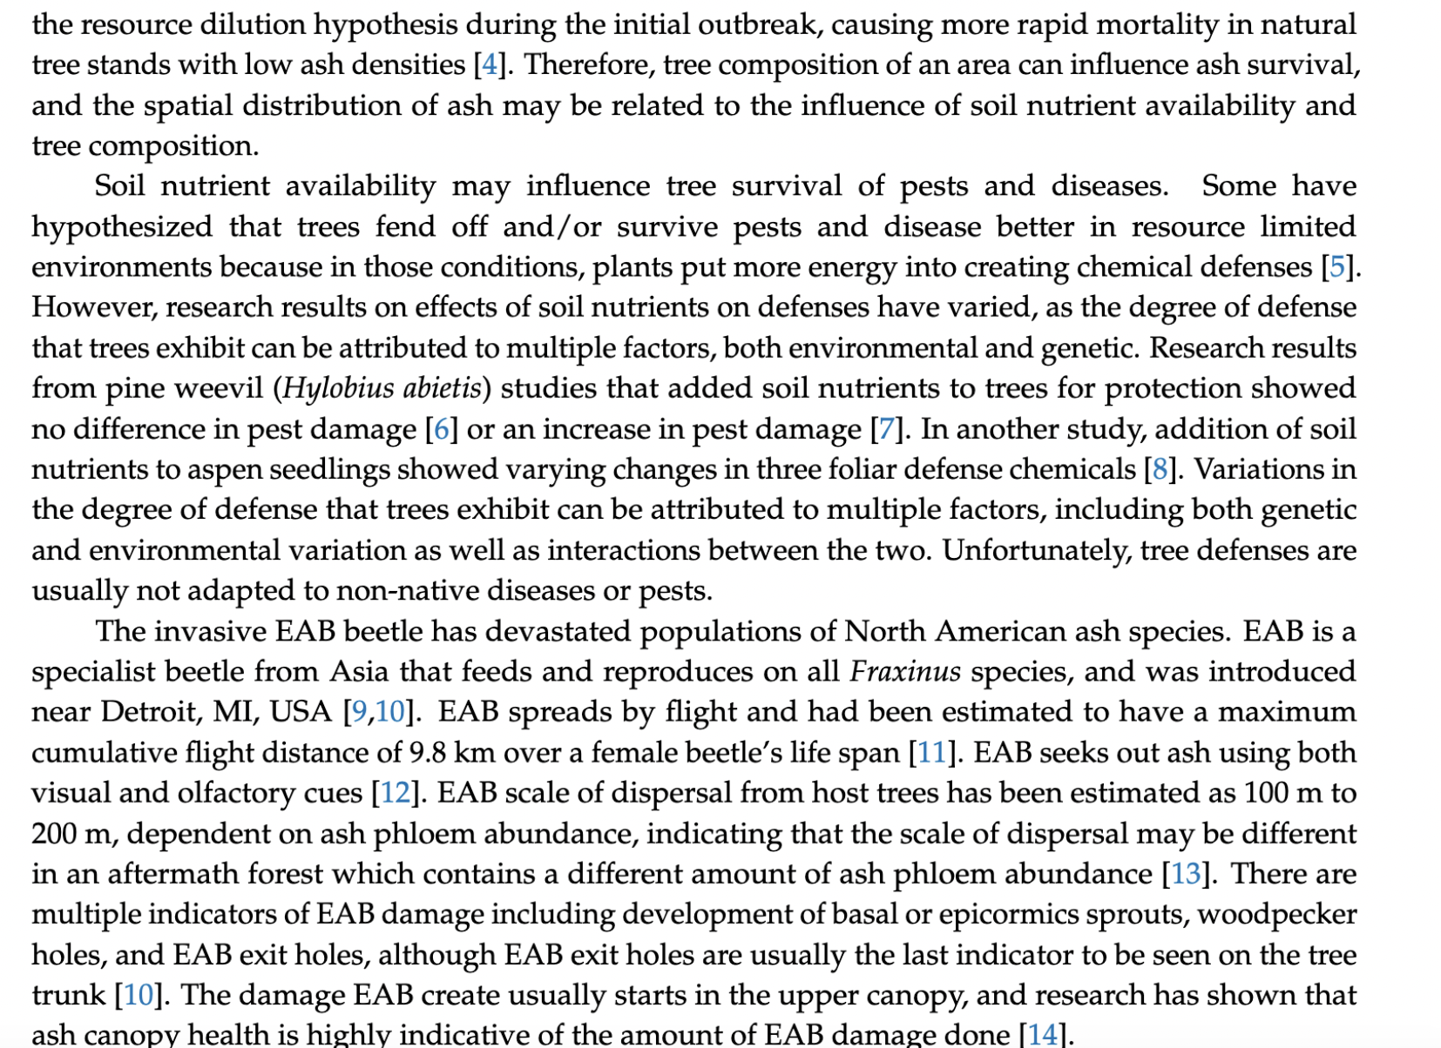

Slide 15
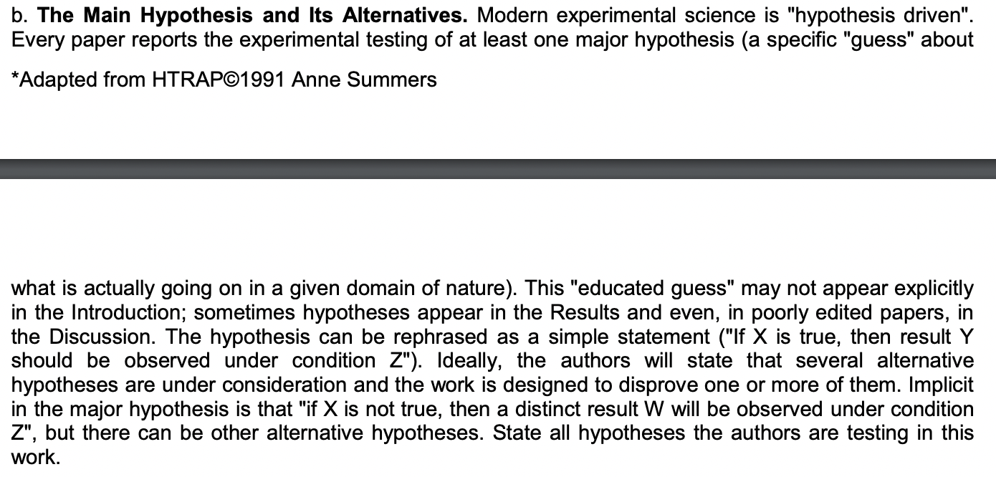
How to Read A Scientific Paper

Slide 16
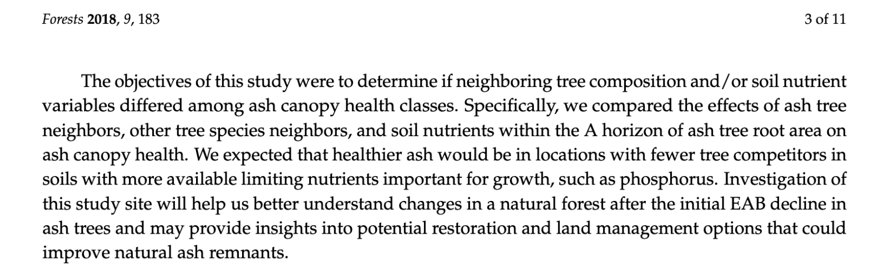

Slide 17
Null hypotheses: Ash tree neighbors do not affect ash tree canopy health. Other tree species neighbors do not affect ash tree canopy health. Soil nutrients within the A horizon of the ash tree root area do not affect ash tree canopy health.
Alternatives: Ash tree neighbors will have a detrimental effect on ash tree canopy health. Other neighboring tree species will have a detrimental effect on ash tree canopy health. Availability of limiting nutrients like phosphorous in the A horizon of ash tree root area will have a positive effect on ash tree canopy health.

Slide 18
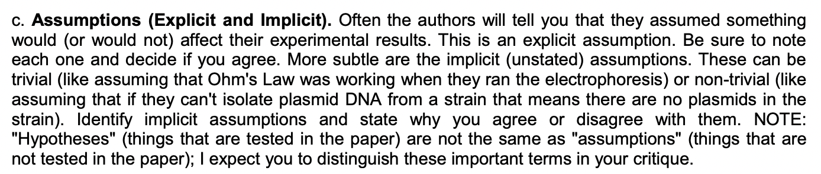
How to Read A Scientific Paper

Slide 19
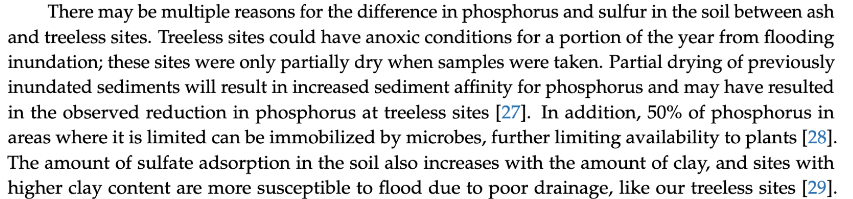
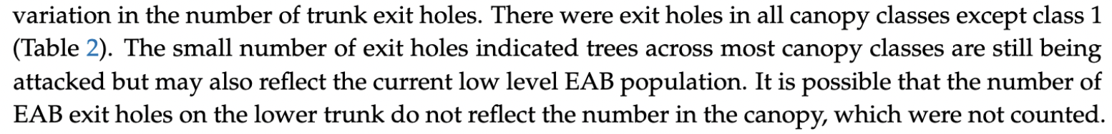
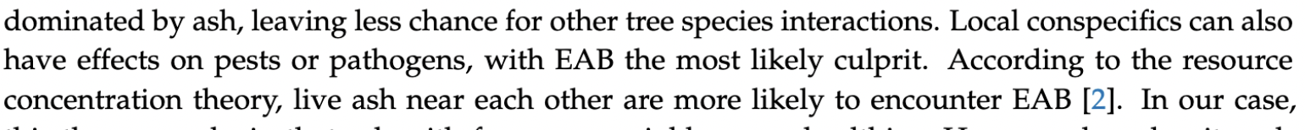

Slide 20
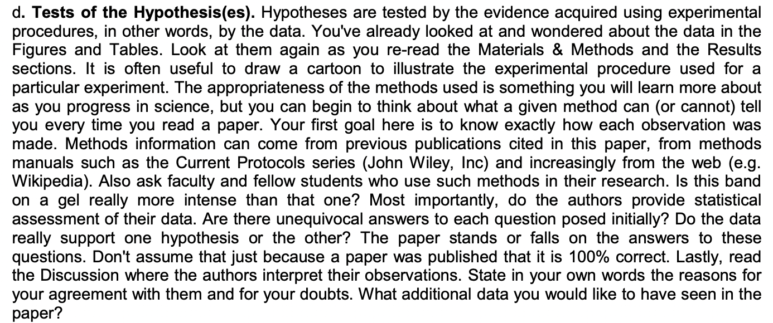
How to Read A Scientific Paper

Slide 21
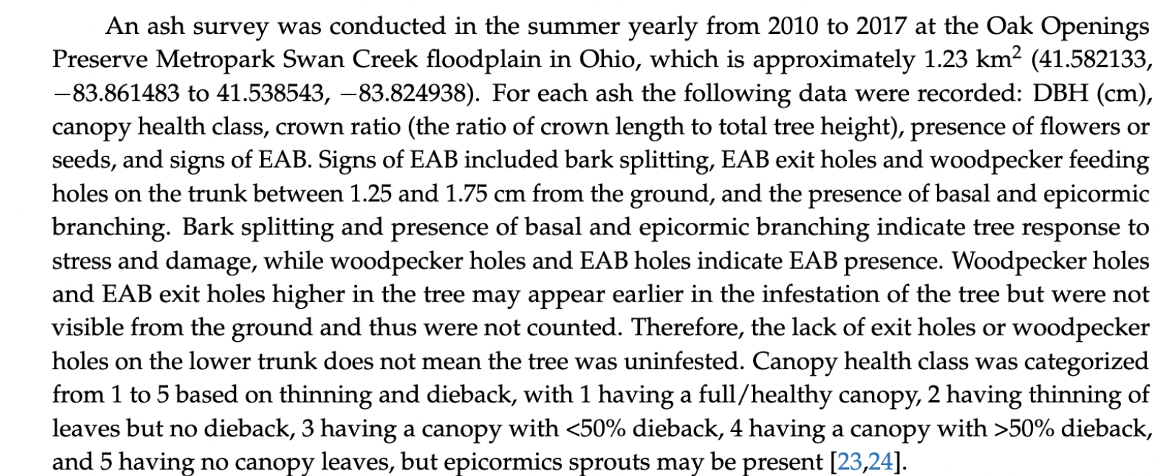

Slide 22
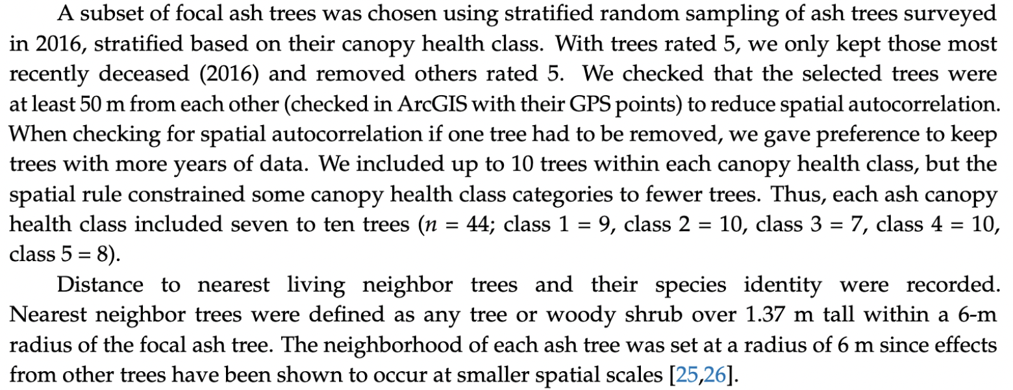

Slide 23
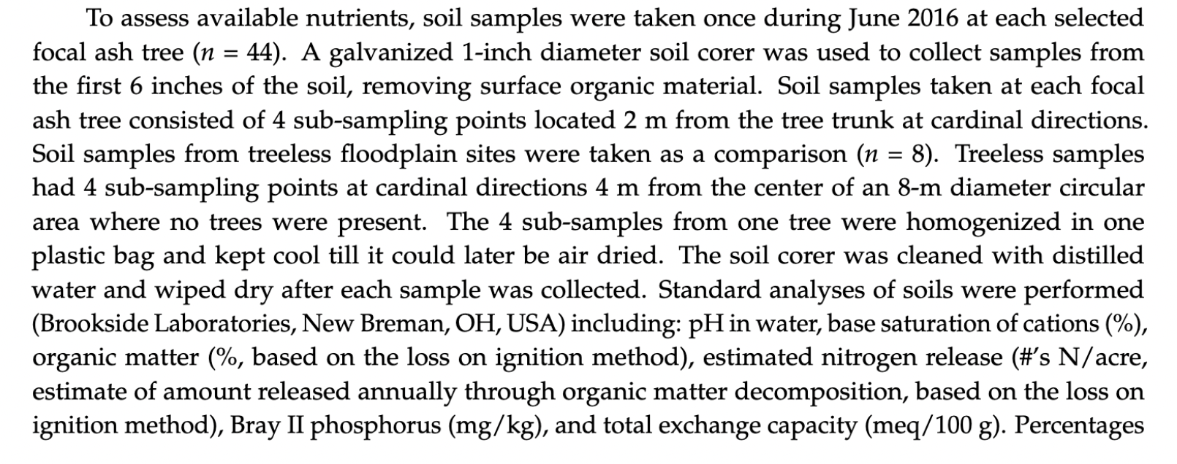

Slide 24
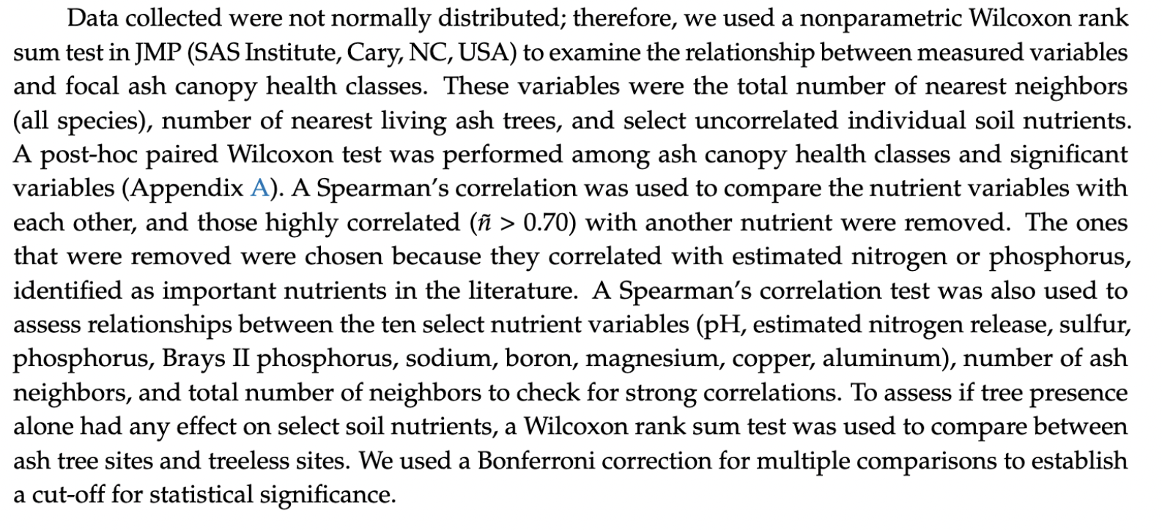

Slide 25
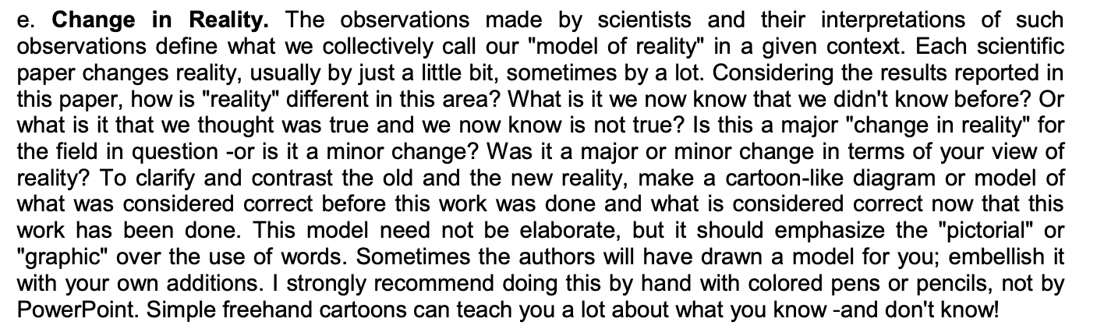
How to Read A Scientific Paper

Slide 26
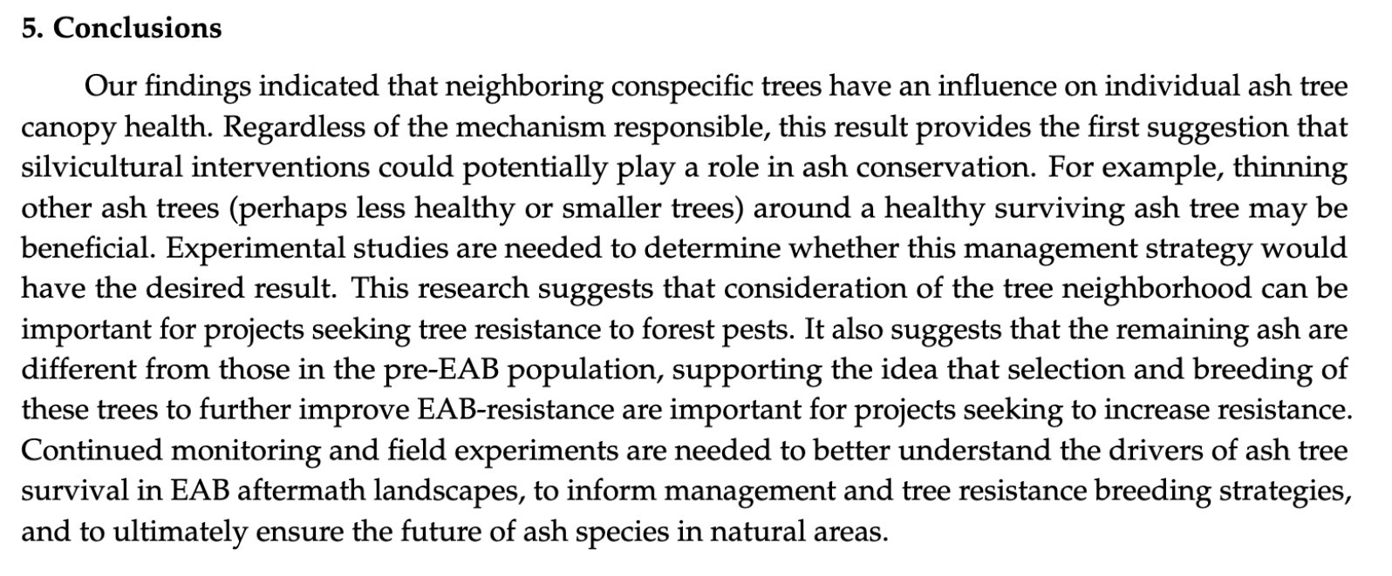

Slide 27
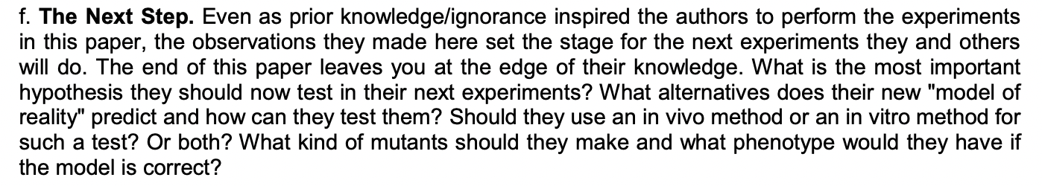
How to Read A Scientific Paper

